Slide 1
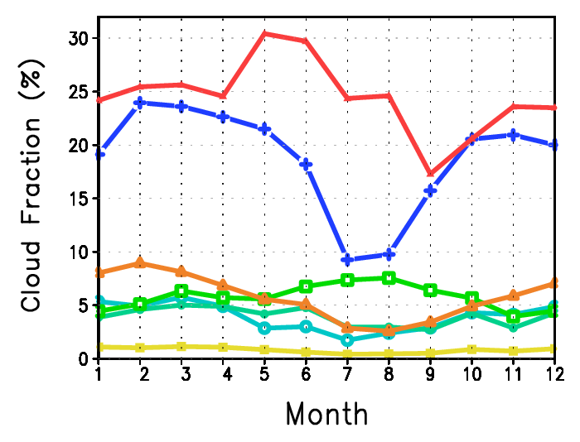
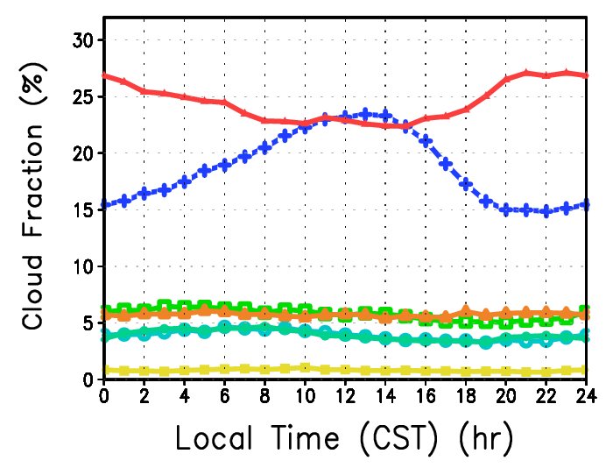
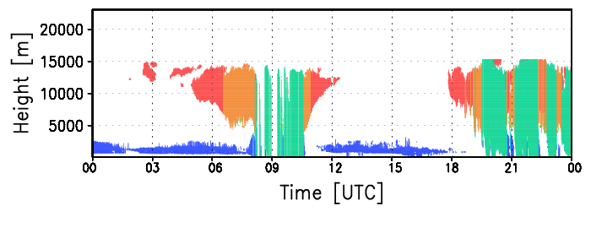
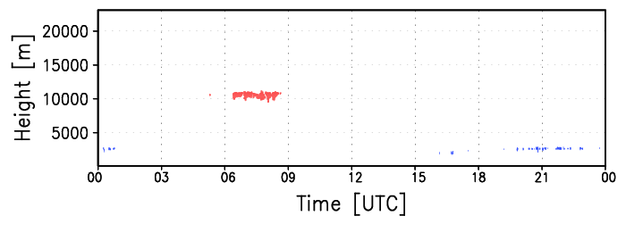
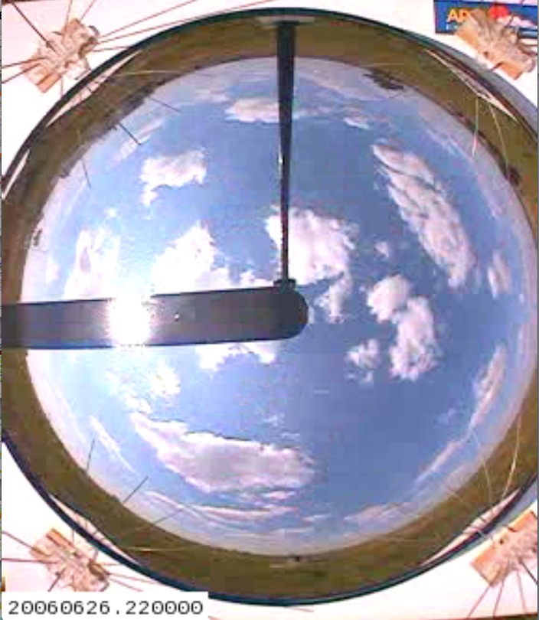
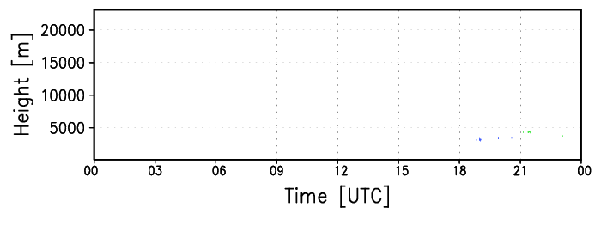
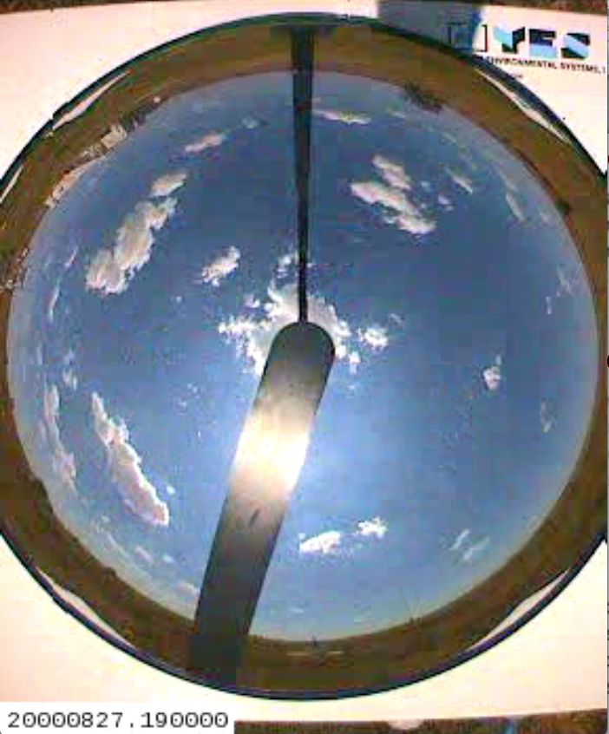
Development of an automated cloud-type classification algorithm
K. Sunny Lim¹, Laura Riihimaki¹, Jessica Kleiss², Larry Berg¹, Yunyan Zhang³, and Yan Shi¹
¹Pacific Northwest National Laboratory, Richland, WA
²Lewis and Clark College, Portland, OR
³Lawrence Livermore National Laboratory, Livermore, CA
4. Results
1. Introduction
Various cloud types have different radiative forcing, thus an automated cloud-type classification is important to better understand the role of clouds on the energy budget, and the regional/global hydrological cycle.
Recently, the DOE/ARM program is expanding its products to include a routine large-eddy simulation (LES) modeling to compliment high-density observations at the SGP site.
Shallow cumulus cloud at the SGP site is the initial focus of this routine LES.
2. Purpose
In order to provide a long-term database of cloud types and to give guidance in choosing not only sub-categories of the classified cloud types but also shallow cumulus events for routine LES modeling over the SGP site, we develop the cloud-type classification algorithm.
1) Classified Cloud Types
Cirrus
Cirrostratus
Example of classified cloud types
Altostratus
14-years (1997-2010) climate variability
Altocumulus
Deep Conv.
Congestus
Time-height evolution of radar reflectivity from MMCR at the ARM SGP C1 site on 24 May 2008
dBZ
Low clouds
Seasonal Cycle
Diurnal Cycle
classified cloud types
Cirrus
Cirrostratus
Altostratus
Altocumulus
Deep Conv.
Congestus
Low clouds
3. Method
2) Fair Weather Shallow Cumulus (ShCu) period
Simple definition of cloud types relying on cloud macrophysical quantities such as cloud height and thickness
Schematic diagram of ShCu selection procedure
Evaluation of algorithm using the dataset from Berg and Kassianov (BK08) and Zhang and Klein (ZK13) during 9 years (2000-2008)
Cloud typ e Cloud base Cloud top Cloud thickness
Classified cloud types
TSI: Altocumulus has larger opaque TSI cloud fraction.
ceilometer: Detected cloud base information from ceilometer is the critical component to distinguish the real clouds from smoke plume.
Hit Miss Overlap False positives Transition Data issues
Low clouds
Congestus
Deep convection
Altocumulus
Altostratus
Cirrostratus/Anvil
Cirrus
< 3.5 km
< 3.5 km
< 3.5 km
3.5 - 6.5 km
3.5 - 6.5 km
3.5 - 6.5 km
> 6.5 km
< 3.5 km
3.5 - 6.5 km
> 6.5 km
3.5 - 6.5 km
3.5 - 6.5 km
> 6.5 km
> 6.5 km
< 3.5 km
≥ 1.5 km
≥ 1.5 km
< 1.5 km
≥ 1.5 km
≥ 1.5 km
No restriction
Selection of single-layer low cloud type
Both (either)
(Large-scale/smoke/Altocumulus)
35 (59) 5 9 17 (3/1/10) 15 17
Example of Hit and Miss cases
0.5 < TSI < 70
0 < ceilometer
Hit (2006.06.26)
If we consider any hit from either BK08 or ZK13, our method shows 73 percent agreement.
Automatic separation of transition between other cloud types (Ci, StCu, Ac) and ShCu is possible. We do not consider these transition cases as fair weather shallow cumulus cases.
Cirrus
BK08: 16-25
ZK13: 16-24
This study: 16-24
Cirrostratus
Frequency of low clouds during 1 hour > 2
Altostratus
Altocumulus
Deep Conv.
Congestus
Data: Top and bottom height of each hydrometeor layer up to 10 layers, detected by the combined MMCR and MPL (Clothiaux et al., 1998) from the Active Remote Sensing of Clouds (ARSCL) (Johnson and Jensen, 2009) at the SGP C1 site. For shallow cumulus period selection, additional measurement data, opaque TSI cloud fraction and ceilometer detected cloud base, are used.
Advantage: It can be easily duplicated in cloud resolving models including a LES model.
Disadvantage: The classified cloud type using this method is sensitive to pre-defied threshold values.
Duration of ShCu > 1.5 h
Separation of each ShCu case > 2.5 h
Low clouds
22:00 UTC
Check Cf_T during ShCu
Miss (2000.08.27)
BK08: 18.5-24.5
ZK13: 18-23
This study: None
Separation of transition case (St, Ci, Ac)
Incorporate VISST to exclude ShCu impacted by large-scale weather phenomena
Cf > 25%
Cld_top > 7.5 km
Selected ShCu
19:00 UTC
Classified cloud types and TSI image
Acknowledgements:
VAP Science Sponsors & Helpful discussions: William Gustafson, Andrew Vogelmann, Jennifer M. Comstock, Chitra Sivaraman, Michael Jensen, and Justin W. Monroe
This work was supported by ARM, as part of CAPI VAP development.
References:
Berg, L., and E. I. Kassianov, 2008: Temporal variability of fair- weather cumulus statistics at the ACRF SGP site. J. Climate, 21, 3344–3358.
Zhang, Y., and S. A. Klein, 2013: Factors controlling the vertical extent of fair-weather shallow cumulus clouds over land: Investigation of diurnal-cycle observations collected at the ARM Southern Great Plains site. J. Atmos. Sci., 70, 1297–1315.
Contact: Kyo-Sun Sunny Lim: kyo-sun.lim@pnnl.gov

