Slide 1
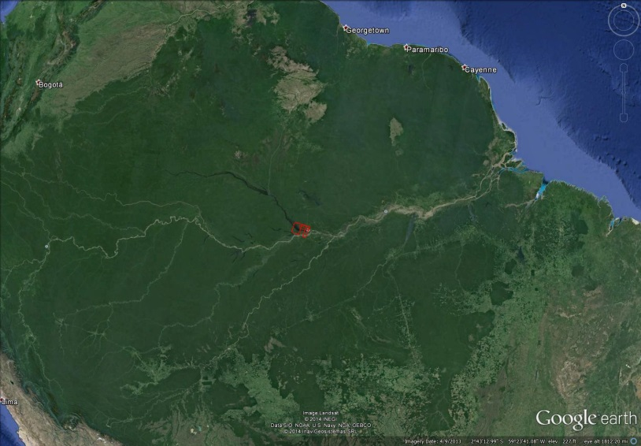
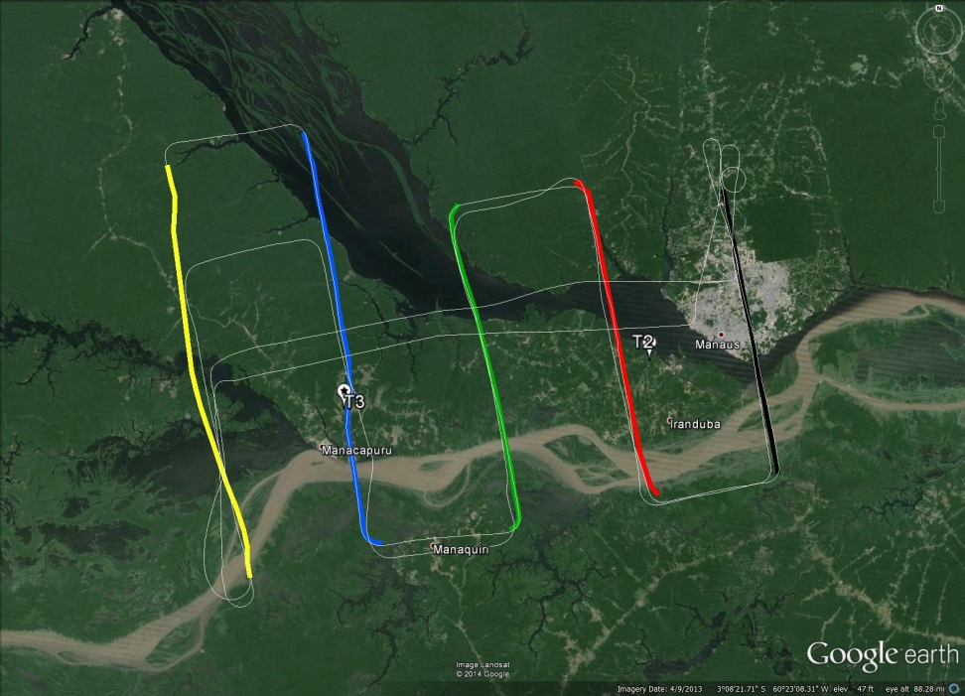
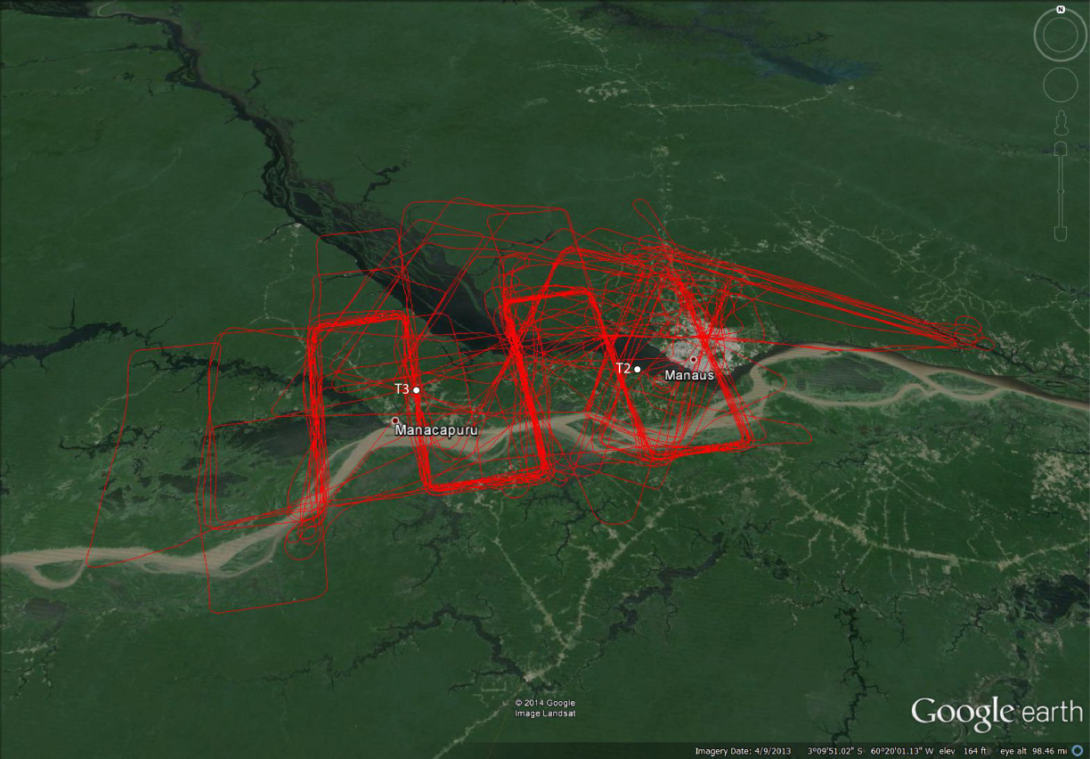
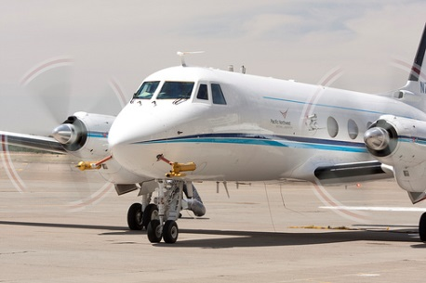
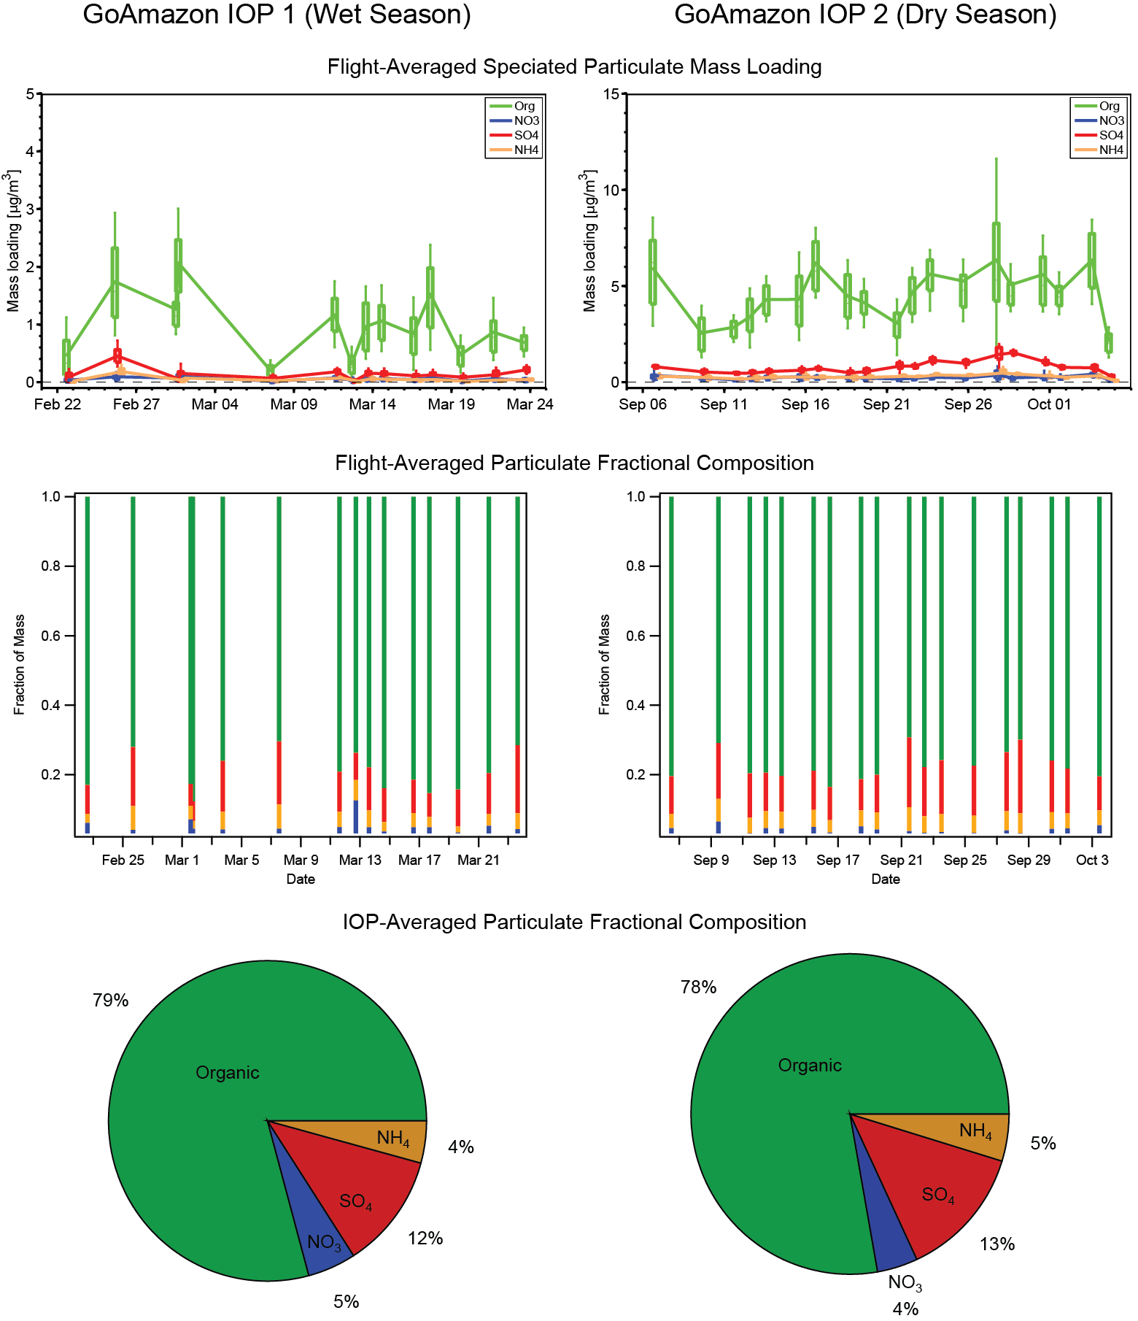
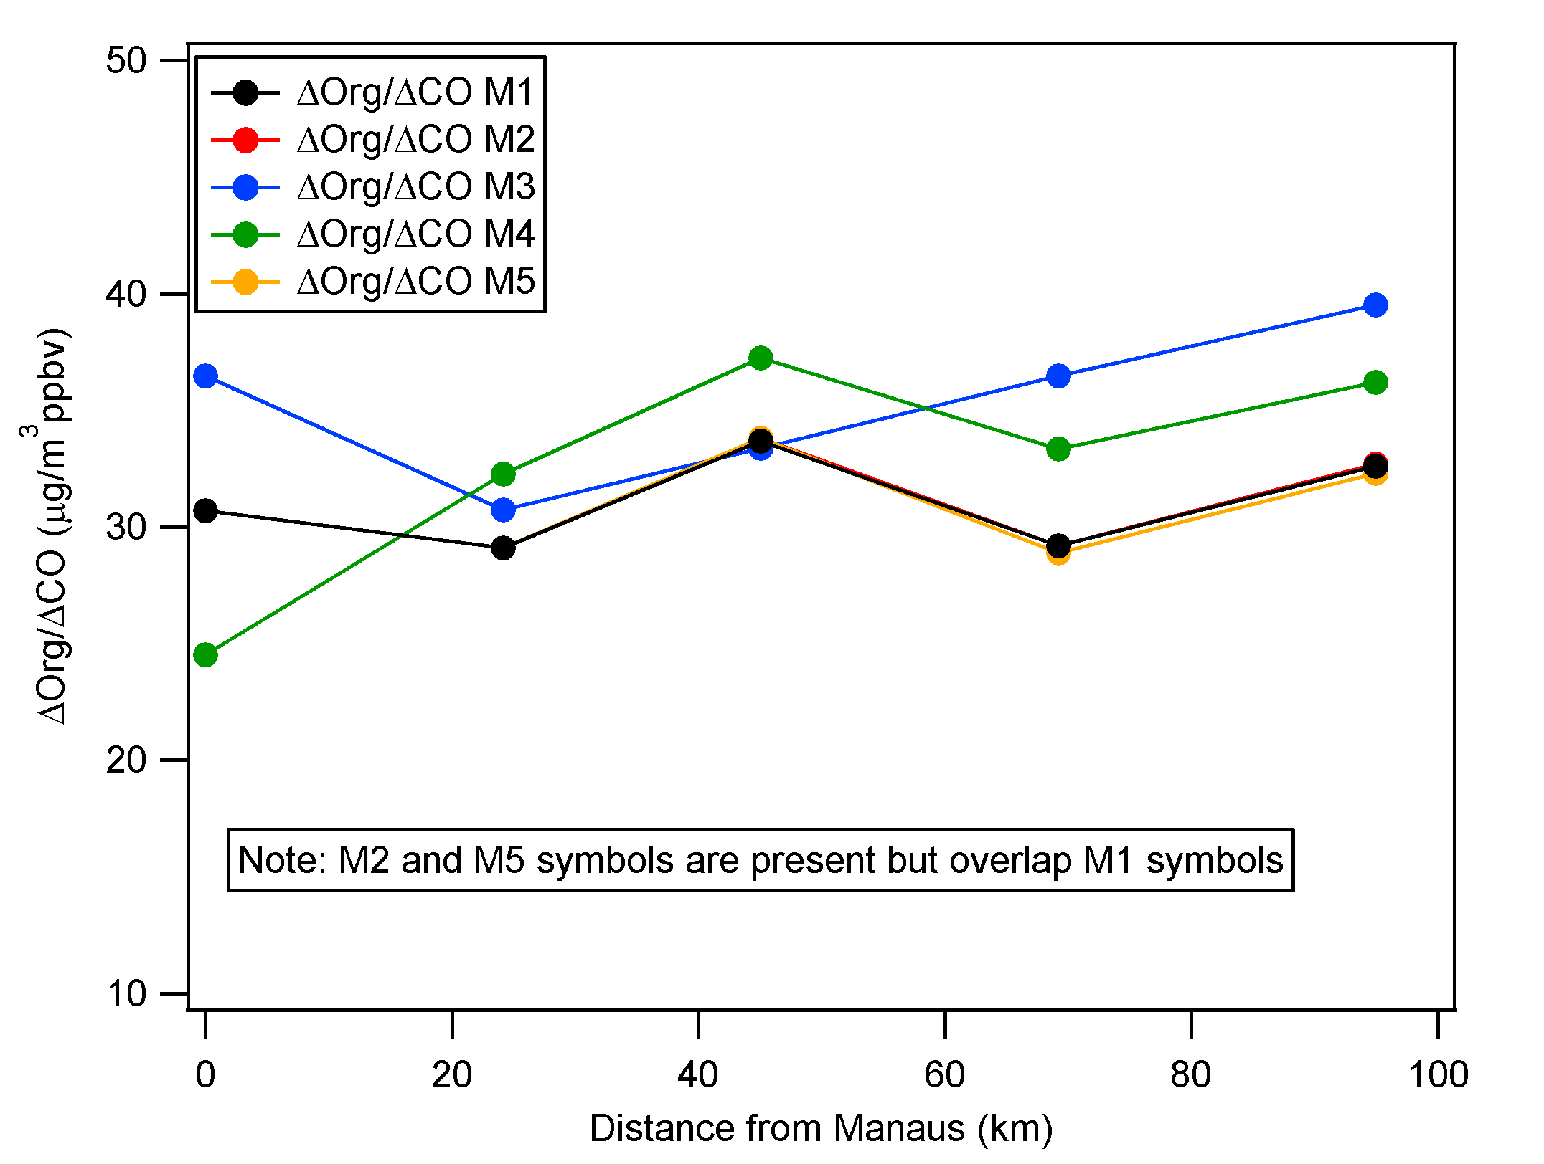
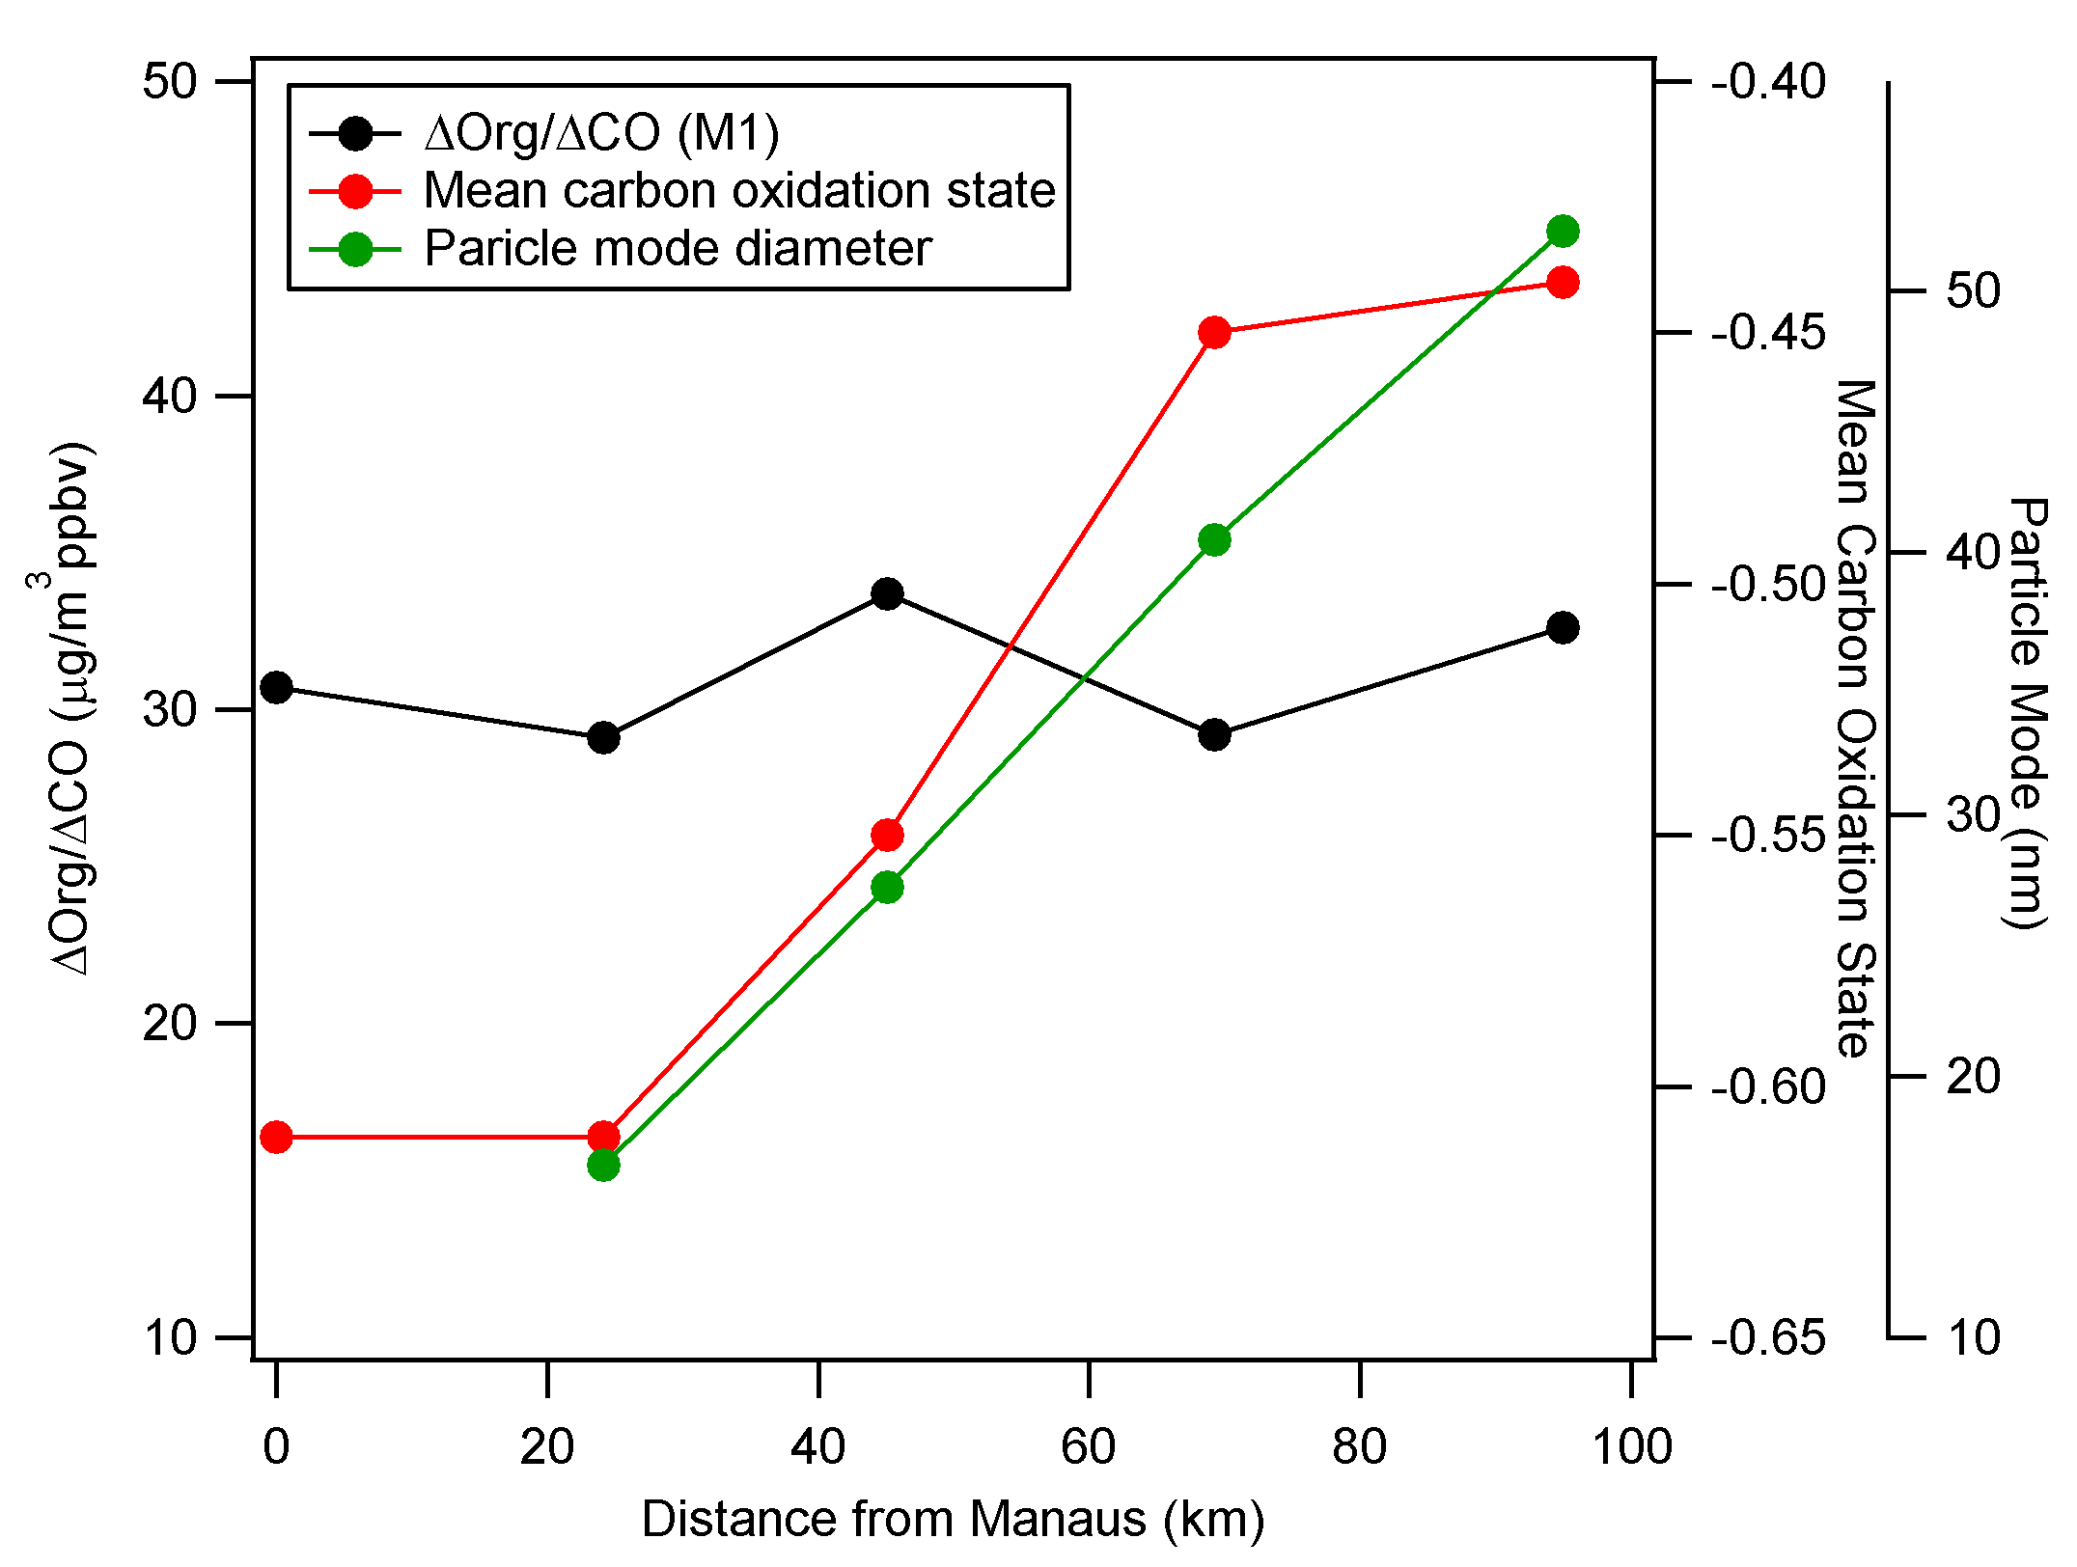
Gas and Particle Measurements onboard the G-1 aircraft during GoAmazon 2014/5
J.E. Shilling¹, M.S. Pekour¹, E. Fortner², P. Artaxo³, M. Canagaratna², J.M. Hubbe¹, K.M, Longo⁴, L.A.T. Machado⁴, S.T. Martin⁵, F. Mei¹, S.R. Springston⁶, J. Tomlinson¹, J. Wang⁶
¹PNNL, ²Aerodyne Research,³University of Sao Paulo, ⁴CPTEC-INPE, ⁵Harvard University, ⁶BNL
GoAmazon G-1 Flight Domain and Strategy
Aerosol Evolution in Manaus Plume – March 13th 2014
G-1 characterized the Manaus plume as it was transported downwind and interacted with biogenic emissions.
IOP1 – Wet Season, February 15th – March 26th 2014
  16 Flights
IOP2 – Dry Season, September 1st – October 10th 2014
  19 Flights.
G-1 Flight Track
OA Formation
G-1 flew a pattern that repeatedly transected Manaus plume downwind.
IOP1 Flight Tracks
Prevailing
Wind
Flight Time Trace
LO-OOA dominates aerosol composition early in flight and correlates with CO.
MO-OOA increases later in flight and correlates with ozone and aerosol SO₄.
Organic O:C lower in the fresh plume.
Observations are consistent with aging of plume downwind of Manaus.
PMF of OA
Overview and Comparison
of Wet and Dry Season Aerosol
Plume is well defined.
Background trace gas and aerosol concentrations are low.
Organic concentrations are elevated in plume.
Significant BVOCs present.
Absolute loading of species is significantly higher in dry season.
Fractional composition is remarkably constant between IOPs.
Acknowledgements
This research is based on work supported by the U.S. Department of Energy, Office of Science, Office of Biological and Environmental Research, Atmospheric Radiation Measurement and Atmospheric Systems Research programs. Pacific Northwest National Laboratory is operated for DOE by Battelle Memorial Institute under contract DE-AC05-76RL01830.
For more information, please contact: John Shilling (john.shilling@pnnl.gov)
Notes:
NOTE: Print this poster file at 100% SCALE to result in a physical print measuring 48” wide x 42” tall. All type size notations shown above are based on the final printed size of the poster.
• Contact Digital Duplicating (375-2969, http://digitalduplicating.pnl.gov) to order poster printing and finishing services for your completed poster design.
• Remember to have your poster cleared for public display/distribution through the ERICA Information Release system (http://erica.pnl.gov).
• Sidebar “About PNNL” box is considered optional, and can be removed if space is needed for technical content.

