Slide 1
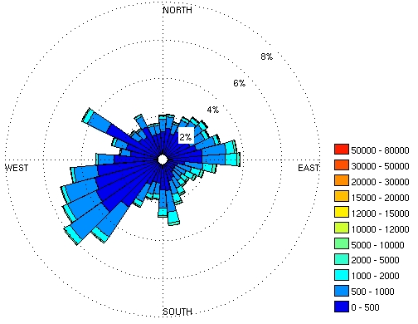
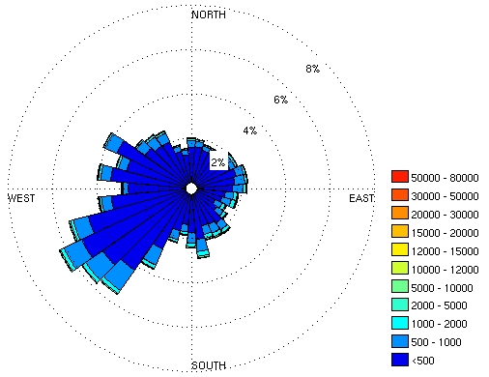
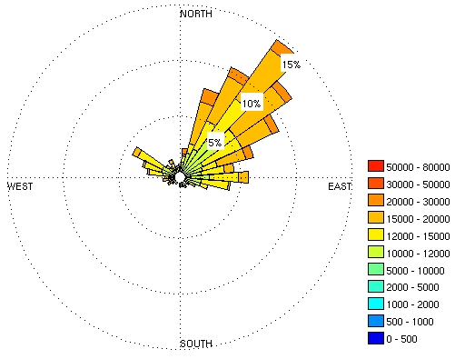
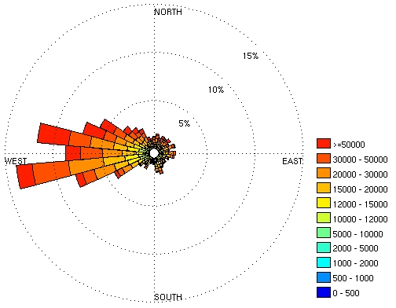
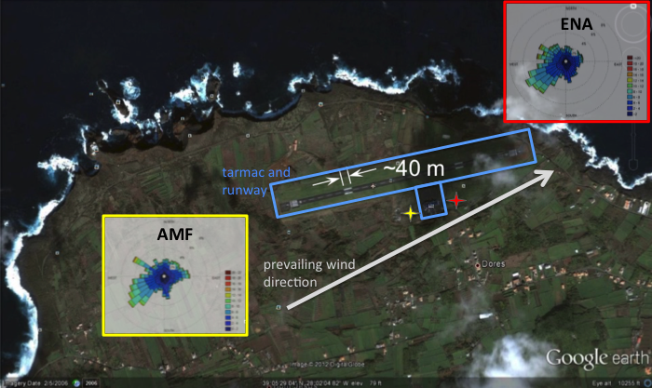
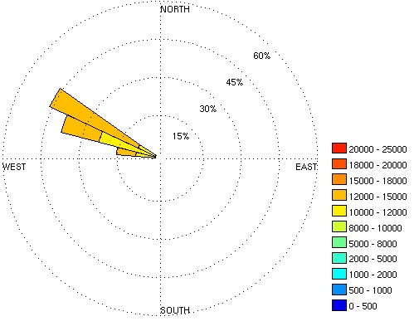
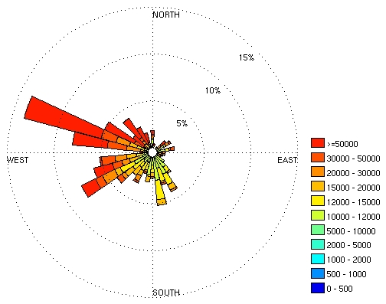
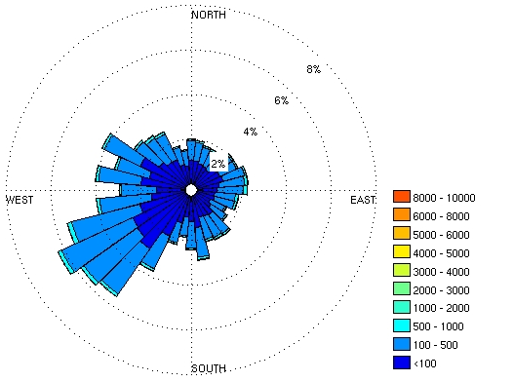
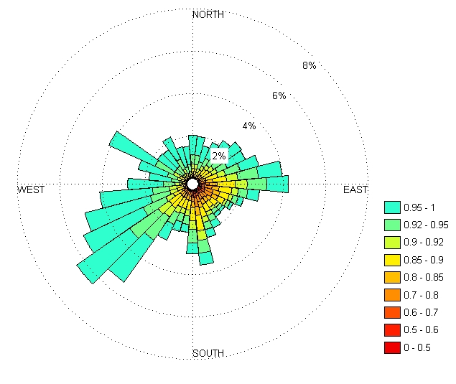
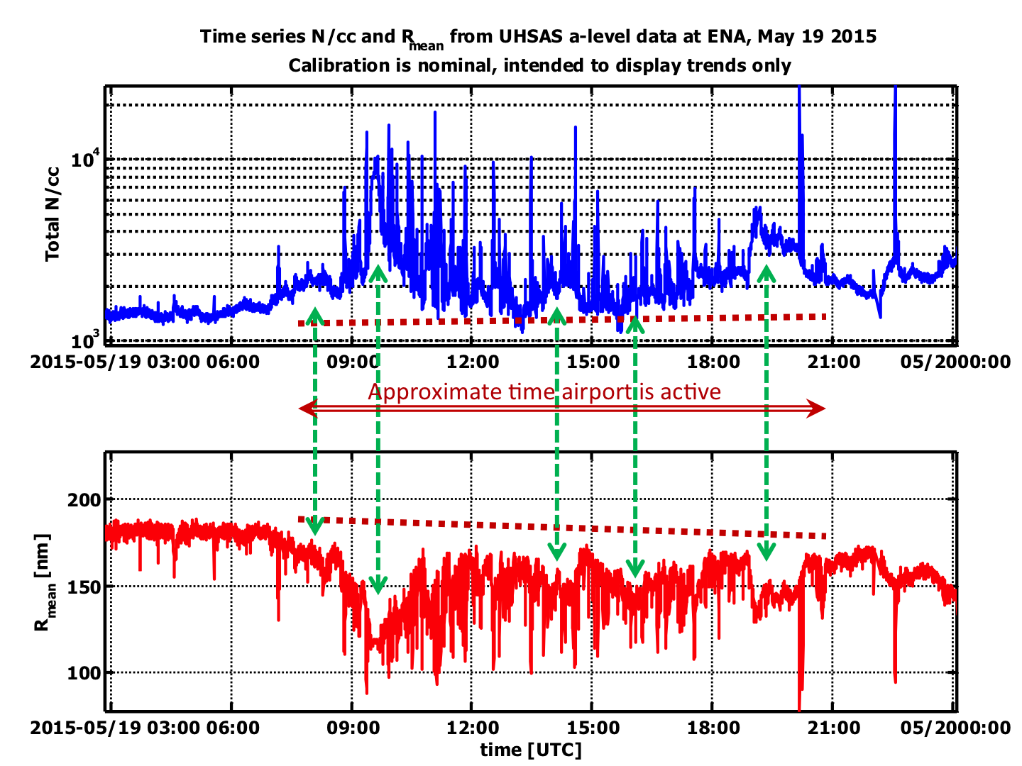
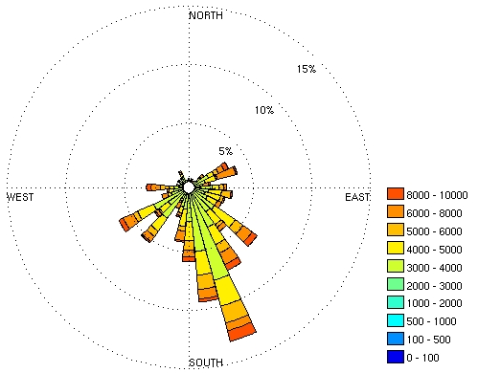
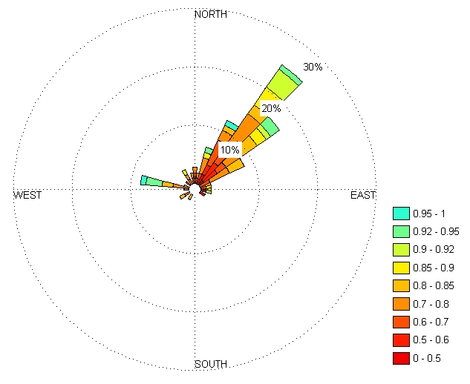
Evaluation of Aerosol Observing System Siting at the ARM Eastern North Atlantic Site: Implications for data quality and meeting ARM and ASR Science Objectives
Doug Sisterson¹, Yan Feng¹, Allison McComiskey², Rob Wood³ Jayson Stemmler³
¹Argonne National Lab, ²NOAA, ³U. of Washington
Context of the AOS
ARM deployments aim to characterize specific regions or regimes for climate process and model evaluation studies
the Aerosol Observing System (AOS) encompasses a wide range of surface in situ aerosol optical, physical, and chemical properties for aerosol radiative effect and cloud interaction studies
AOS measurements are highly sensitivity to local aerosol sources and siting can have large implications data quality and measurements intended for regional-scale scientific objectives
Aerosol Number Concentration by Wind Direction
Findings and Future Applications
Aerosol number concentration measurements show strong evidence of contamination from airport emission
Aerosol light scattering and other optical properties may be less sensitive to contamination by fresh emissions
Next steps:
a comprehensive evaluation of all measured aerosol variables will help to quantify the nature and extent of contamination from airport and sea spray emissions
a limited, portable measurement system is being considered for deployment at > 1 km from the airport to assess whether the same patterns persist with distance from source
The intent of this work is to:
improve the utility of the AOS measurements at ENA
serve as a case study for optimizing future AOS siting
develop potential data mitigation approaches for contamination situations (e.g., automated contamination flagging or different approache to averaging data such as using medians rather than means)
AMF
ENA
CN < 10000
CN > 10000
Siting Issues at ENA
All AOS measurements are made as part of a larger system that samples common air through an elevated stack to avoid turbidity produced by surface activities. Nonetheless, contamination of AOS measurements may come from:
Sea spray from the nearby coastline
Emissions from the neighboring airport tarmac and runway traffic (aircraft and motor vehicle) – idling vehicles are common on the tarmac
Low aerosol number concentration (CN) (< 10000) follows the prevailing wind direction at both locations but high CN concentrations (> 10000) point to the airport tarmac at both locations. Vehicle particle emissions are small and numerous and the CN measurements is sensitive to this class of aerosol.
CN > 10000
night only
Aerosol Light Scattering and Absorption by Wind Direction
Scattering σ_{s} and single scattering albedo ω₀ measurements (Dp < 1µm) show skewness, but not as extreme as CN. Small particles from fresh emissions are not as efficient at scattering light at the wavelengths measured but are strongly absorbing (ω₀ < 0.9). Results are for AMF only.
Airport emission only are considered in this work. The graphic above shows relative locations of the airport runway and tarmac, coastline, CAP-MBL AMF-1 deployment (2009-2010) west of the tarmac, and permanent ENA AOS deployment (2014-present) east of the tarmac. Wind roses indicate wind direction and speed measured during the two separate deployments.
If traffic is primarily restricted to daytime, then nighttime patterns should not be indicative of airport influence. The daytime CN data (not shown) follows the all data patterns but the nighttime CN data is less conclusive than the high CN data.
AMF
σ_{s} (CN<10000)
ω₀
(CN<10000)
Evidence Potentially Significant Data Contamination
CCN < 3000
Evidence of airport emissions contamination can be seen in the high resolution data at left, representing a single day, and also in the box whisker plot representing data from the full CAP-MBL AMF deployment below that exhibits extreme skewness.
CCN > 3000
σ_{s} (CN>10000)
ω₀
(CN>10000)
Sharp spikes are likely due to very fresh emissions, while wider enhancements in the data, indicated by green arrows, may be due to more diffuse, older emissions. Alternatively, these wider features are representative of regional processes creating difficulty in quality controlling the data for scientific use.
All Cloud Condensation Nuclei (CCN) data do not differ from CN patterns, however the high CCN data do not seem to be affected by airport traffic. High CCN data should be a different population of aerosol, larger and more hygroscopic than fresh vehicle emissions.
There is evidence that airport emissions may impact measurements of aerosol absorption, but seem to have little effect on scattering.
please contact the authors or any AMSG representative to provide input

