Slide 1
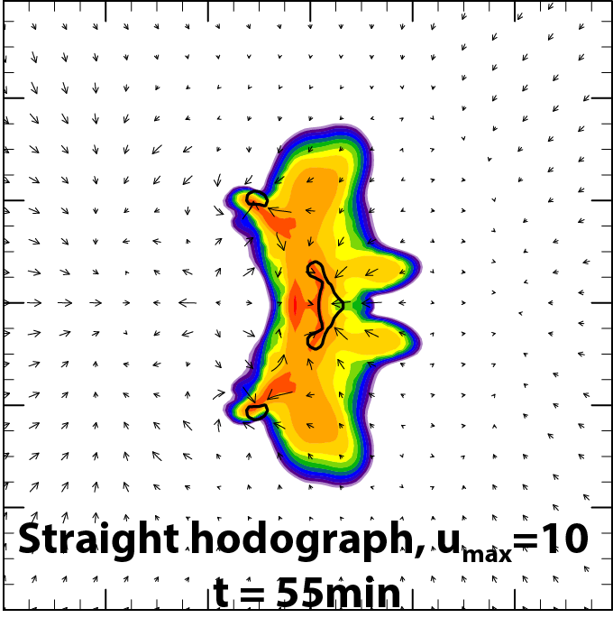
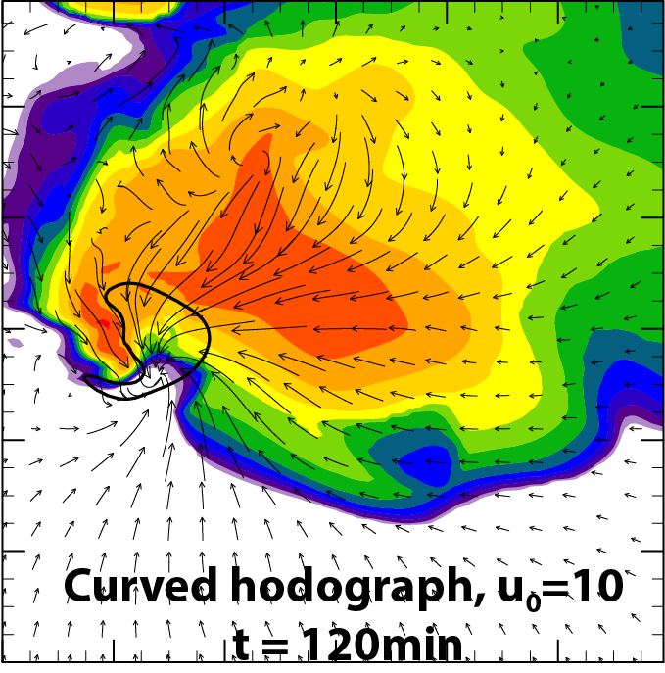
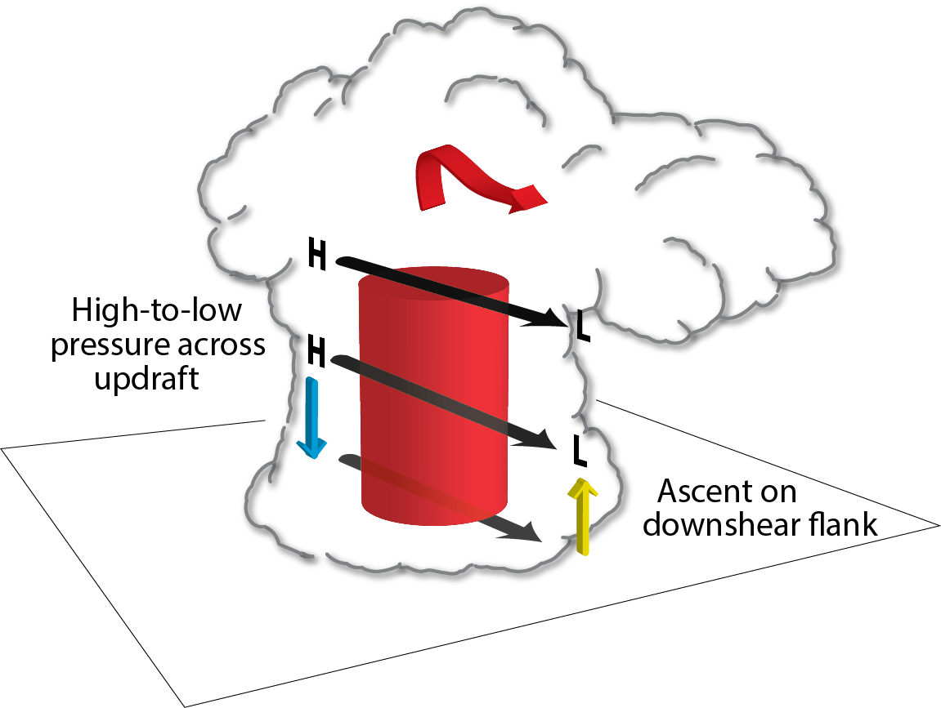
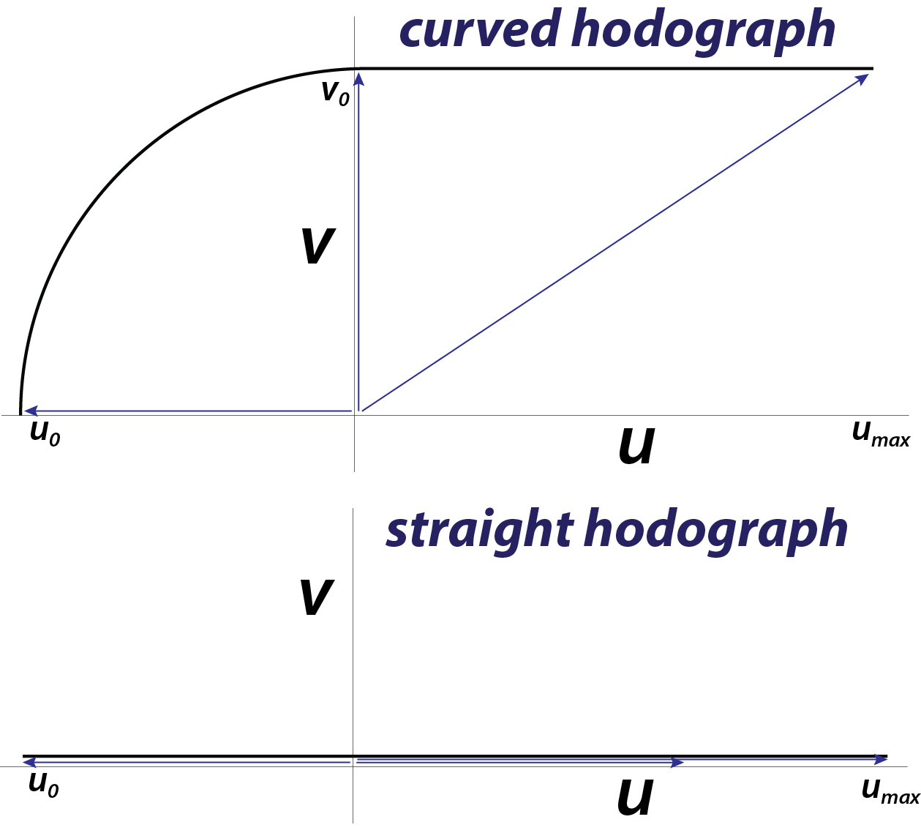
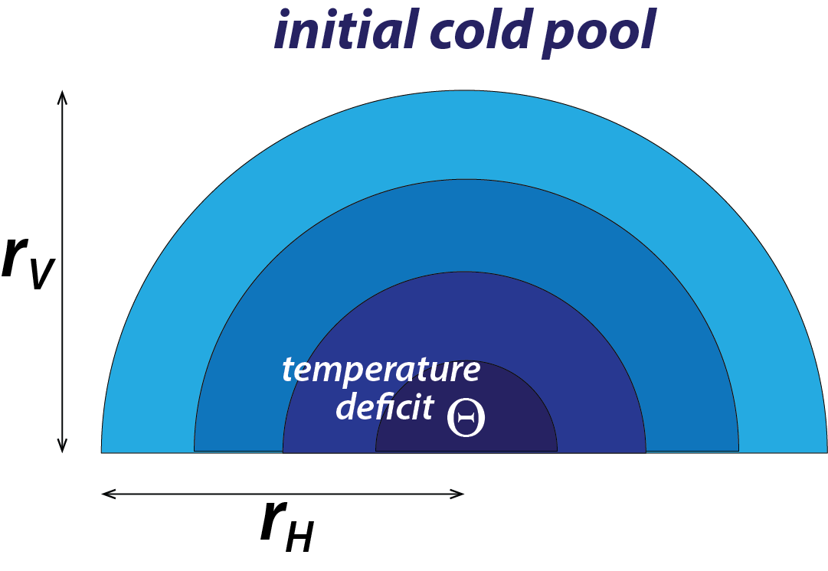
Controls on the Widths of Intense Convective Updrafts
R. J. Trapp, G. R. Marion, S. G. Lasher-Trapp, S. Nesbitt
University of Illinois at Urbana-Champaign
DOE award DE-SC0014101
jtrapp@illinois.edu, gmarion2@illinois.edu,
slasher@illinois.edu, snesbitt@illinois.edu
Introduction
A strong relationship between the size and intensity of the updraft, downdraft, and surface-based cold pool within a precipitating convective cloud can be demonstrated with numerical models and explained using basic physical arguments. A relationship between the cold pool and the initiation of new convective updrafts is also readily demonstrated and explained.
What is less clear is how the cold pool characteristics modulate the size and intensity of this new updraft. The size, or horizontal area, of a convective updraft is of particular interest because it governs the entrainment rates as well as vertical mass fluxes.
Herein we use rather simplistic experiments for the very specific purpose of evaluating the convective response to cold-pool type forcing within different environmental wind distributions.
Example Simulations
In these two baseline cases, the impulsive cold pool expanded laterally and then initiated deep convection on its downwind side within 15-30 min. The (supercellular) updraft in the curved-hodograph case continued to grow in time; (multicellular) updrafts in the straight-hodograph case ceased their growth after 60 min.
Color fill is of simulated reflectivity factor at z = 750 m. Contour is 20 ms⁻¹ vertical velocity at z = 5.25 km. Vectors are of horizontal wind at z = 750 m.
Results
Interpretation and Implications
Our interpretation of these results is that the effects of the environmental wind shear on updraft area dominate those of the cold-pool forcing.
The key implication regards the neglect of vertical wind shear in convective parameterization schemes. The wind-shear effect emphasized here goes beyond the shear-modulation of convective morphology.
Thus, even though inclusion of a parameterized cold pool will improve representation of convection initiation, it will not necessarily improve the representation of the salient characteristics of the convection.
straight hodograph
curved hodograph
Cold-pool depth (r_{V})
the peak updraft area shows a weak dependency on the cold pool depth (Note: only weak initiation when r_{V}= 2 km)
Method
We employ the CM1 model for this study. Notable details about the setup are as follows:
500 m grid lengths in the horizontal and vertical
domain size of 300 x 300 x 20 km
Weisman thermodynamic profile
Morrison double moment microphysical parameterization (with hail)
We perform a series of idealized simulations in which the convective-storm evolution and characteristics are controlled jointly by the environmental wind/temperature profile and an initially prescribed cold pool. In the experiments presented here, we vary either the environmental wind profile (Fig. 1), the vertical depth (r_{V}) of the cold pool, or the initial temperature deficit (Θ) of the cold pool (Fig. 2).
Analysis:
The model analysis here is limited to a determination of the horizontal area of the updraft. We quantify this using the number of contiguous gridpoints with vertical velocity w ≥ 20 ms⁻¹ at a height z = 5.25 km. By design, the updraft area is that of the updraft core.
Our hypothesized physical explanation is based on the “linear dynamics” pressure effect, which is a high-to-low pressure variation across the updraft, in the direction of the wind shear vector.
Cold-pool temperature deficit (Θ)
the peak updraft area shows a slightly larger dependency on the cold pool temperature deficit
Stronger vertical shear implies a stronger resultant vertical pressure gradient force and thus stronger vertical accelerations. Analyses of decomposed pressure will be used to address this hypothesis.
Fig. 1. Environmental shear profiles: The curved hodograph is modified such that u₀ (= v₀) is varied from 6 to 14 m s⁻¹. The straight hodograph is modified such that u_{max} is varied from 5 to 25 m s⁻¹. The baseline values are u₀ = 10 m s⁻¹ and u_{max} = 10 m s⁻¹.
Environmental wind shear
peak updraft area has an even larger dependency on environmental shear, especially with hodograph curvature
Fig. 2. Initial cold pool parameters: The deficit Θ is varied over 2.5 to 10 K and the vertical depth (r_{V}) is varied over 2 to 6 km. The baseline values are Θ = 5 K and r_{V} = 3 km, respectively. The horizontal radius (r_{H}) is held constant at 30 km.
Future Work
We plan to examine the sensitivity of updraft area to the environmental thermodynamics. Alternative quantifications of the draft characteristics (e.g., PDFs) are also planned, as are experiments that will explore other means of initial updraft forcing. This research is one part of a broader effort to use MC3E analyses and idealized/real-data simulations to address the influences of cumulus entrainment, microphysical processes, land surface, and convective environment on convective cold pools and their impacts.
m = 3.2

