Slide 1
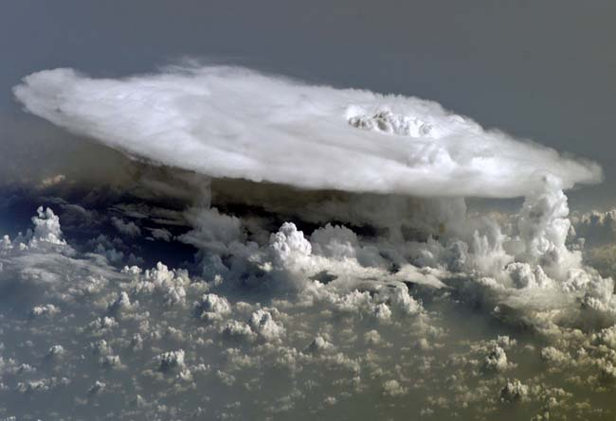
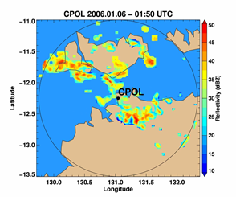





A transition matrix for stochastic modeling of the population dynamics of convective clouds
Samson Hagos¹ , Zhe Feng¹ , Robert Plant² , Robert Houze¹ and Alain Protat³
¹PNNL, ²University of Reading, ³Australian Bureau of Meteorology
Background
Objective
Informed by analysis of radar observations, cloud permitting model simulations and theory, the study aims to develop probabilistic models of non-equilibrium dynamics of cloud populations for:
Testing hypotheses regarding the roles of various physical processes and
Parameterizing the spectrum of convective clouds (from isolated to MCSs) in a unified framework.
The Transition Matrix
Current conceptual models underpinning parameterizations of the interaction between convection and the environment have relied on an unrealistic assumption that slowly varying large-scale environment is in statistical equilibrium with a large number of small and short-lived clouds.
(a) Development
(c) Interpretation
C-Pol observation at Darwin
12 winters of C-Pol radar scans are used to identify convective cells.
Steiner et al. (2005) algorithm is used to identify convective cells and stratiform areas.
A snapshot of convective cells observed by C-POL radar located at Darwin, Australia.
Process I
Convective clouds populations cover a spectrum of sizes and lifetimes and are often in transition
(Courtesy of NASA).
Process III
Process II
Machine learning
A simple machine learning algorithm is constructed using TensorFlow. With the C-Pol radar observed time series of convective cell size distributions as an input, the algorithm uses Adaptive Moment Estimation (ADAM) optimizer to solve Eq. (1) for T.
The population dynamics is governed by primarily three processes:
Process I Lifecycle of convection: Cells form, grow and decay.
Process II Positive feedback: The presence of large cells favors the formation of new small cells possibly through cold pool dynamics.
Process III Negative feedback: The presence of very large cells suppresses the formation and growth of small cells possibly through stabilization of the environment.
A TensorFlow graph of the algorithm
The Stochastic Framework
(b) Validation
Size distribution vs area fraction
C-POL (Obs)
STOMP- Transition Matrix model
When forced by the rate of change of area fraction. The transition matrix model predicts the size distribution as a function of area fraction and diurnal cycle well.
Summary and Future Work
Convective cloud population from C-band radar observations at Darwin and a machine learning algorithm are used to construct a transition matrix for stochastic modeling of population dynamics of cloud populations. The matrix represents lifecycle of convection as well as direct cloud-cloud interactions.
The framework will be extended to include stratiform area and hence of formation of MCSs and will be implemented into a mass flux scheme.
Transition to size
Transition from size
A simplification:
If a convective pixel is to be added to (removed from) the domain, the probability that a convective cell of size will gain (lose) that pixel such that:
for addition
and
Diurnal cycle of size distribution
C-POL (Obs)
STOMP- Transition Matrix model
for removal
is given by
File Name // File Date // PNNL-SA-#####
is the transition matrix.
This research was supported by the U.S. DOE’s ASR Program via the ICLASS SFA and the ARM Climate Research Facility.
Notes:
NOTE: Print this poster file at 100% SCALE to result in a physical print measuring 48” wide x 42” tall. All type size notations shown above are based on the final printed size of the poster.
• Contact Digital Duplicating (375-2969, http://digitalduplicating.pnl.gov) to order poster printing and finishing services for your completed poster design.
• Remember to have your poster cleared for public display/distribution through the ERICA Information Release system (http://erica.pnl.gov).
• Sidebar “About PNNL” box is considered optional, and can be removed if space is needed for technical content.

