Slide 1


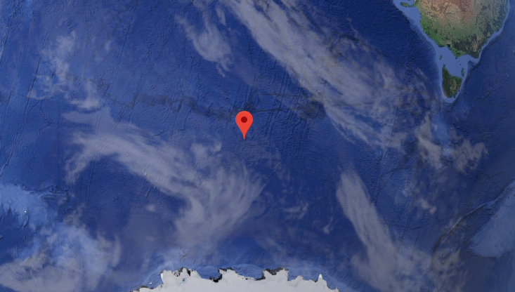
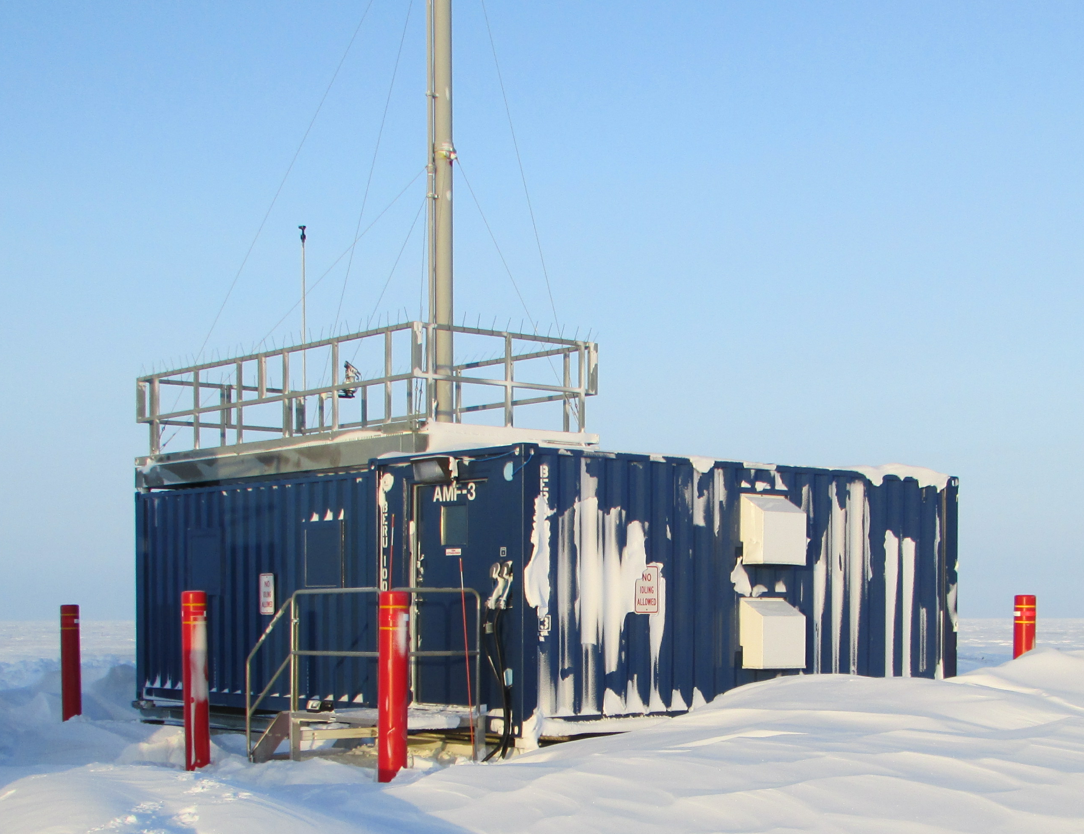
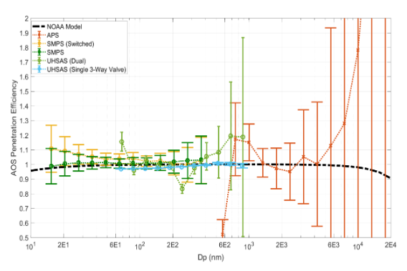
Making Aerosol Observing Systems Work for Research
Stephen R. Springston¹, Scott Smith ¹, Sebastien Biraud², Matthew Boyer¹,
Connor Flynn³, Chongai Kuang¹, Jenni Kyrouac⁴, Cynthia Salwen¹,
Arthur Sedlacek III¹, Janek Uin¹ and Tom Watson¹
¹Brookhaven National Laboratory, ²Lawrence Berkeley National Laboratory,
³Pacific Northwest National Laboratory, and ⁴Argonne National Laboratory
Corresponding author: Stephen R. Springston, srs@bnl.gov, (631) 344-4477
Accomplishments in the Last Year
Mandate: To provide in situ characterization of atmospheric aerosols, their precursors and ancillary measurements to better understand the radiation balance of the atmosphere.
Plans for Upcoming Year – Optimizing Measurements to Research Needs
Based on AMSG report, Triennial Review recommendations, feedback from Users and Mentor input, ARM continues to refine aerosol measurements to maximize scientific impact. ARM will continue to support focused aerosol measurements at 5 locations. High priorities for the new year are listed in the ARM Aerosol Measurement Strategy (draft) and will include (list not inclusive):
Inlet Drying for Optical Properties – Particle mass can vary with humidity by > 8X. The inlet stream for scattering and absorbance will be dried to < ~35% RH to make the 1/10-µm Impactor cut unambiguous. This was a priority recommendation of the AMSG. Drying to a fixed level will be done with a large Nafion drier to avoid decomposition from heating.
LASIC (AMF1) 2016-06-01 to 2017-10-31 – MAOS A/C regularly detected aged biomass-burning aerosol from Africa. A complete suite of aerosol characterization provided chemical, microphysical, and optical properties over the course of two burning seasons. Comprehensive in-situ measurements were necessary to show the boundary-layer only loosely correlated with total optical depth measured by remote sensing.
Tang and Munkelwitz, JAMS, 1994, 33, 791-6.
PSAP/TAP Filter Successor – ARM has made filter-based, absorbance measurements for over 20 years. That filter media is no longer available. Constrained laboratory experiments will provide quantitative limits on reported data taken before/after the change over. A ~one-year intercomparison will be done at SGP to further bound the limits when sampling ambient aerosols.
Zuidema et al. GRL submitted
ENA (and all AOS) Site Local Contamination – ARM will develop autonomous routines for identifying local sample contamination. The Satellite Site at ENA and AAF overflights during ACE-ENA will be used to validate algorithms to identify non-regionally representative sampling. Such local contamination is unavoidable at most ARM sites. Following BNL Machine Learning efforts in FY 17, will generate local emission mask as an ARM PI Data Product.
MARCUS (AMF2) 2017-09-01 – 2018-04-01 - AMF2 sailing in the Southern Ocean used aerosol instrumentation to measure size distribution and optical properties in context with remote sensing of clouds. The robust engineering of the AOS allows measurements to be made under challenging conditions and limited communications.
ENA and ENA Satellite Site 2017-06 – ongoing to determine how to flag non-regionally representative data.
AMF3 at Oliktok – commence summer-only operation of CCN-200 and HTDMA which are vulnerable to unplanned hard freezing.
G. Senum preliminary analysis
Convert MAOS A/C into AMF1/MAOS – To better focus activities ARM will reconfigure MAOS-A in AMF1 AOS and suspend operation of the MAOS-C as an integrated system. The AMF1 AOS will contain a complete suite of aerosol instruments. Deployment of components from MAOS will be reviewed on a case-by-case basis.
SGP – 2017-08 - Commenced operations! New HTDMA installed, 2017-10. A re-engineered f(RH) installed 2018-03. SGP now contains most extensive suite of aerosol instrumentation in ARM. Example: Allowing new particle formation to be studied with n-SMPS and SO2 instruments.
SGP – Completion of Instrument Suite. SGP will be test bed for instrument trials, and new configurations given transportation access, good connectivity and long data record at this original ARM site. Ozone analyzer will be added to provide information on atmospheric state in response to user requests.
Kuang, 2017 ARM STM
TEI Model 49i Ozone Analyzer
Laboratory Studies – The AOS Inlet Characterization experimentally demonstrated transmission efficiency between 10 nm < D_{p} < 1 µm. Results demonstrate confidence in reported size distribution from SMPS and UHSAS. Future studies planned to extend range D_{p} > 10 µm.
Mentors and the AMSG will continue to engage with the science community through breakout sessions, workshops, surveys and support interactions with the goal of assessing science priorities and how ARM can best advance its capabilities to support those priorities.
DOE/SC-ARM-TR-191
Acknowledgements: The delivery of aerosol data to the scientific community could not be done without the tireless contributions of on-site techs, support at Operator’s laboratories (ANL: SGP, LANL: AMF1, AMF2 and ENA, SNL: AMF3), the ARM Data Center, and the ARM Data Quality Office.
Additional Accomplishments –
Harmonization of most AOS instruments to b1 level
ACSM workshop 4/11/17
Extending lower range (D_{p} < 3 nm) of a commercial CPC
Redesigned and hardened pump/drier box (AMF2, AMF3, SGP)

